Slide 1

CO₂ Storage Programme

Slide 2
CO₂ Storage Programme
Why a CO₂ Storage Research programme

Slide 3
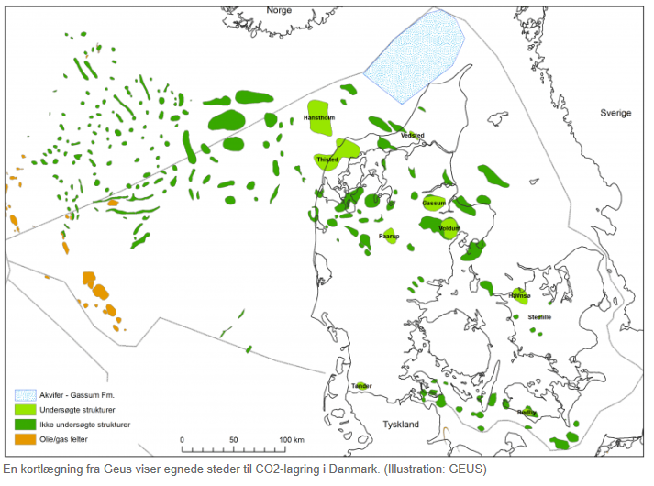

Why CO₂ Storage in Denmark?
Denmark’s climate goal:
70% emission reduction by 2030
Climate neutrality by 2050
0.4 million t/y CO₂ reduction in 2025
Secure CO₂ storage by 2025

Slide 4
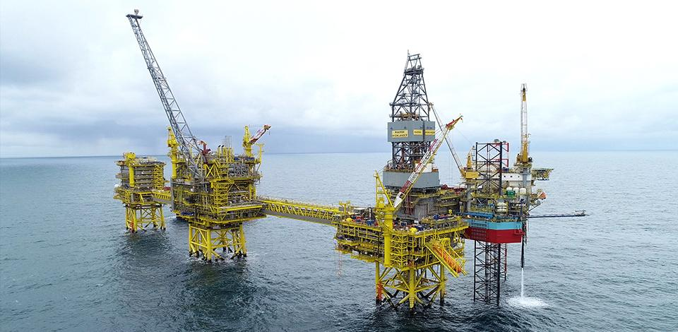
Why CO₂ storage in old Oil and Gas fields?
The depleted reservoirs and the infrastructure in oil and gas fields represent an opportunity for accelerated implementation of CO₂ storage in Denmark:
Storage with:
with a high chance of technical feasibility
a large and well described storage capacity
decades of accumulated knowledge on subsurface behaviour
existing subsurface and surface infrastructure
distance to shore and inhabited areas
Enabling CO₂ Storage +/-10 years before new sites

Slide 5
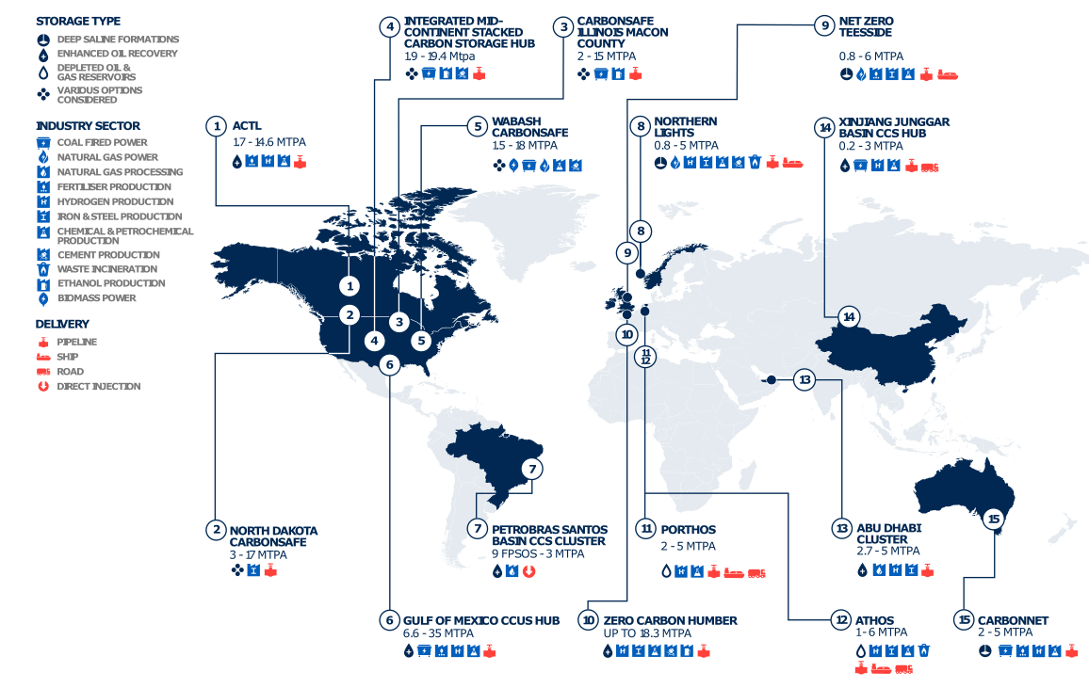
CO₂ storage projects around the world
Technology already mature enough for CCS projects around the world, however, there is a need for;
improved cost efficiency
solutions to specific Danish challenges
Global CCS Institute. Global Status of CCS 2020; 2020.

Slide 6
Why is DHRTC initiating research within CO₂ storage?
We feel we are optimally placed to make a difference due to:
DHRTC’s research network
DHRTC CO₂ storage state of the art study
DHRTC working relation with DUC partners

Slide 7
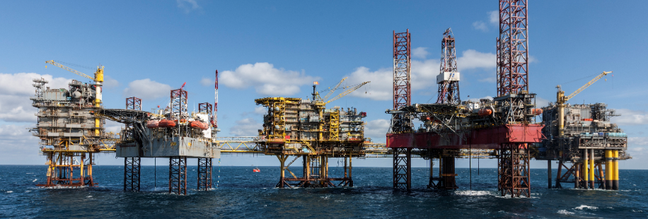
DHRTC CO₂ storage programme - Vision
Enable cost effective and low risk CO₂ storage
Tailored for offshore Denmark

Slide 8
Process – CO₂ Storage Programme Initiation
CO2 State-of-the-Art report (finished Jan-21)
DHRTC decision to initiate programme
DHRTC formulate scope
Framing Session DUC/researchers
May 26th
DHRTC Ideation Session
Deadline for proposals
(start August)
Project Selection (tentative end September)
Research Initiation (tentative Q4-21)

Slide 9
Aim of CO₂ Storage Ideation Workshop
Generate Ideas for research projects which can answer the research questions within the given frame:
    Understand selected challenges, questions and frame
    Generate research ideas
    Create cross discipline/university ideas and network

Slide 10
CO₂ Storage Programme
Programme Frame

Slide 11
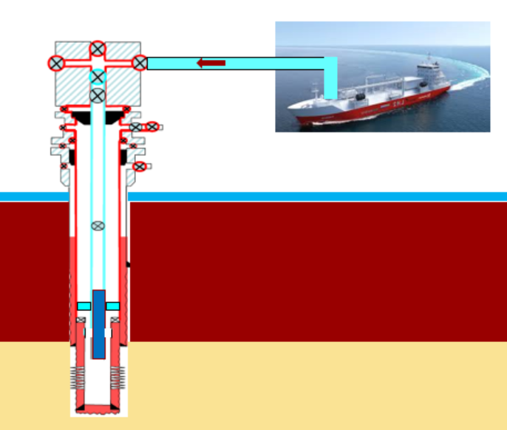
Highlevel frame for DHRTC CO₂ Storage Programme
Research to focus on CO₂ storage offshore Denmark in old oil and gas fields
No research in CO₂ capture
No research in CO₂ transport
No research in CO₂ EOR
CO₂ utilization only included if can be linked to storage in reservoir
Research projects are not to include PhD's

Slide 12
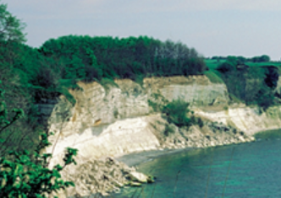
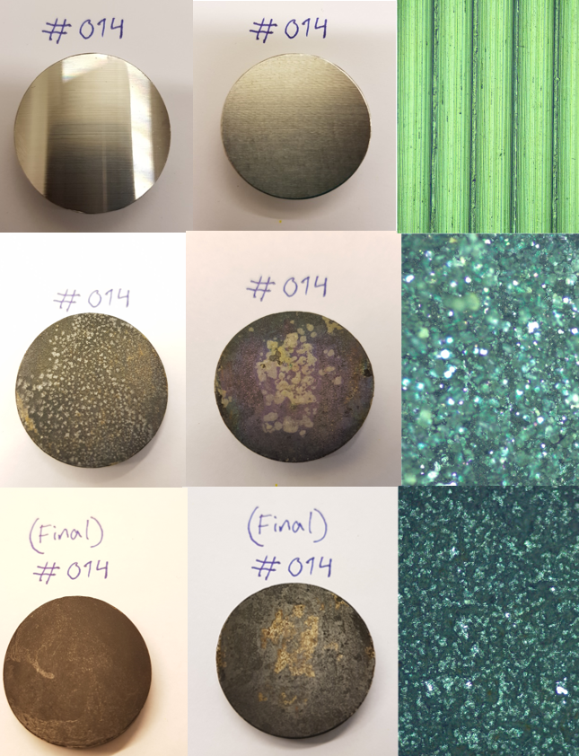

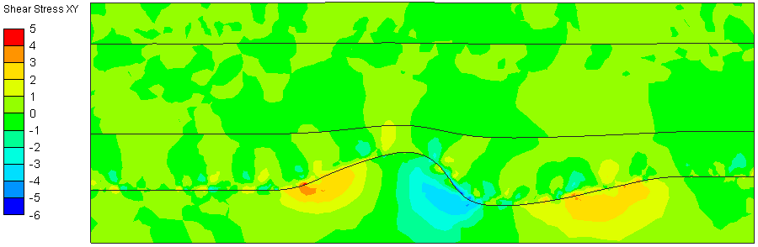
CO₂ storage programme – scope
Reduce CCS project cost, uncertainties and environmental impact
Crazy Ideas
Chalk vs CO₂ storage
Monitoring – New Ideas
Well related issues
Is Chalk suitable for CO₂ Storage?
No
Stop Point (for chalk)
Yes
Open for more research
Short Projects -
Taking advantage of infrastructure and subsurface knowledge
Leak detection
Plume movement
Can existing wells be re-used
Remaining lifetime?
Lifetime extension
Barrier material vs CO₂
Behaviour at DUC reservoir conditions

Slide 13
CO₂ Storage Programme
Submission of proposals

Slide 14
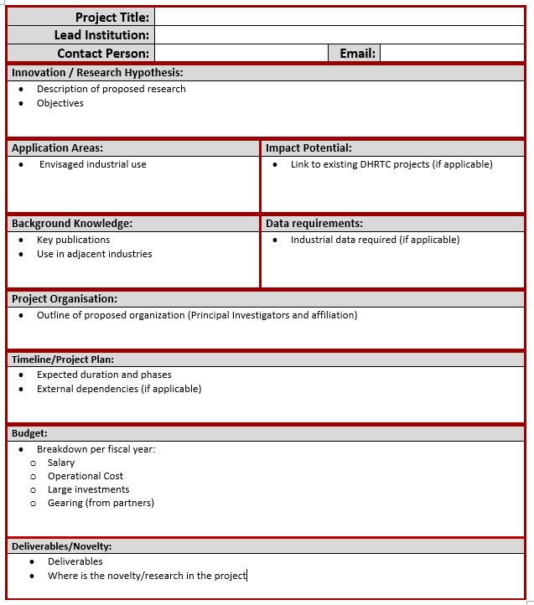
Project Proposals
DHRTC standard application form (homepage)
Submit proposals by email to: DHRTC-Ideas@dtu.dk with copy to clarsen@dtu.dk
Submission Deadline – August 13th
Response – Tentative October 1st
Key to write where the novelty in the project is as we encourage innovative and novel ideas
Feasibility studies encouraged for monitoring and Crazy ideas
  For crazy ideas 3-4 month duration

Slide 15


Project Proposals
No firm length of proposal
We might ask questions after submission to ensure we understand the aim correctly
We are very open to discuss ideas and answer questions in the proposal process (limited in week 29, 30 and 31)
We like proposals with several partners/disciplines:
    If project only makes sense if both parts are made send in a joined proposal
    If the projects can be run individually but you would like to corporate send in separate proposals but explain the links
For some projects it might be a good idea to phase proposal and have check points – we encourage this
Selection criteria:
Are proposals directed at solving a scope research question and within frame
Novelty within industry and research (we might seek expert advise)
Cross-Disciplinary Research
We have to be able to build an overall programme which has an impact within the available funding

Slide 16

Cost effective and low risk CO₂ storage
tailored for offshore Denmark

